Slide 1
Fundamentals of Reinforcement Learning
Temporal Difference Learning
Part-IV
Notes:
1

Slide 2
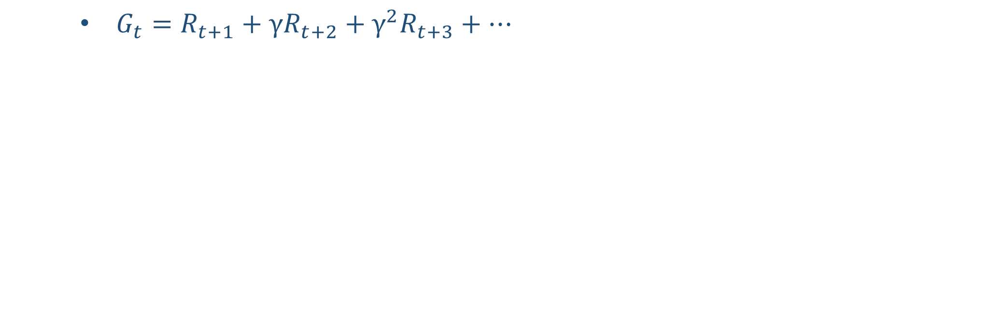
Expected Returns
$G_{t}=R_{t+1}+{γR}_{t+2}+γ^{2}R_{t+3}+…$
Notes:
2

Slide 3

Expected Returns
$G_{t}=R_{t+1}+{γR}_{t+2}+γ^{2}R_{t+3}+…$
$G_{t}=R_{t+1}+{γ(R}_{t+2}+{γR}_{t+3}+…$)
Notes:
3

Slide 4

Expected Returns
$G_{t}=R_{t+1}+{γR}_{t+2}+γ^{2}R_{t+3}+…$
$G_{t}=R_{t+1}+{γ(R}_{t+2}+{γR}_{t+3}+…$)
$G_{t}=R_{t+1}+γG_{t+1}$
Notes:
4

Slide 5
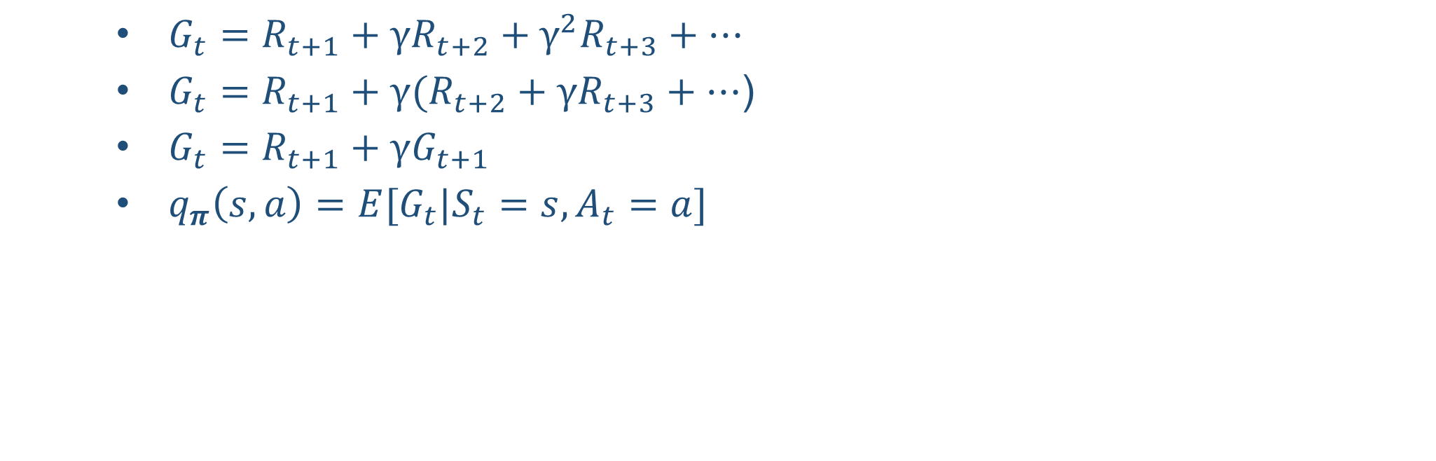
Expected Returns
$G_{t}=R_{t+1}+{γR}_{t+2}+γ^{2}R_{t+3}+…$
$G_{t}=R_{t+1}+{γ(R}_{t+2}+{γR}_{t+3}+…$)
$G_{t}=R_{t+1}+γG_{t+1}$
$q_{π}\left(s,a\right)=E[G_{t}|S_{t}=s,A_{t}=a]$
Notes:
5

Slide 6

Expected Returns
$G_{t}=R_{t+1}+{γR}_{t+2}+γ^{2}R_{t+3}+…$
$G_{t}=R_{t+1}+{γ(R}_{t+2}+{γR}_{t+3}+…$)
$G_{t}=R_{t+1}+γG_{t+1}$
$q_{π}\left(s,a\right)=E[G_{t}|S_{t}=s,A_{t}=a]$
$q_{π}\left(s,a\right)=E\left[R_{t+1}+γG_{t+1} | S_{t}=s,A_{t}=a\right]$
Notes:
6

Slide 7

Expected Returns
$G_{t}=R_{t+1}+{γR}_{t+2}+γ^{2}R_{t+3}+…$
$G_{t}=R_{t+1}+{γ(R}_{t+2}+{γR}_{t+3}+…$)
$G_{t}=R_{t+1}+γG_{t+1}$
$q_{π}\left(s,a\right)=E[G_{t}|S_{t}=s,A_{t}=a]$
$q_{π}\left(s,a\right)=E\left[R_{t+1}+γG_{t+1} | S_{t}=s,A_{t}=a\right]$
$q_{π}(S_{t},A_{t})=E[R_{t+1}+γq_{π}\left(S_{t+1},A_{t+1}\right)]$
Notes:
7

Slide 8
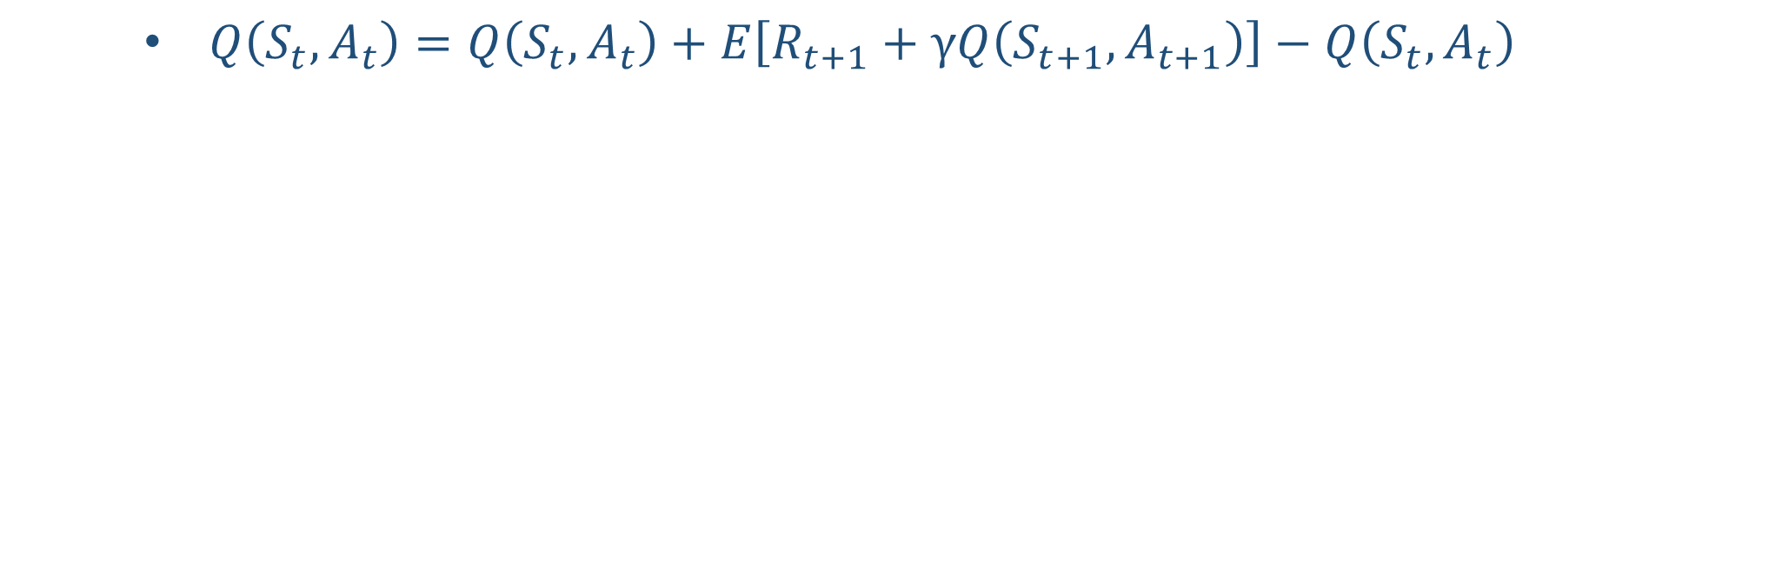
Temporal Difference Update
$Q\left(S_{t},A_{t}\right)=Q\left(S_{t},A_{t}\right)+E\left[R_{t+1}+γQ\left(S_{t+1},A_{t+1}\right)\right]−Q\left(S_{t},A_{t}\right)$
Notes:
8

Slide 9

Temporal Difference Update
$Q\left(S_{t},A_{t}\right)=Q\left(S_{t},A_{t}\right)+E\left[R_{t+1}+γQ\left(S_{t+1},A_{t+1}\right)\right]−Q\left(S_{t},A_{t}\right)$
$Q\left(S_{t},A_{t}\right)=Q\left(S_{t},A_{t}\right)+α(\left[R_{t+1}+γQ\left(S_{t+1},A_{t+1}\right)\right]−Q\left(S_{t},A_{t}\right))$
Notes:
9

Slide 10
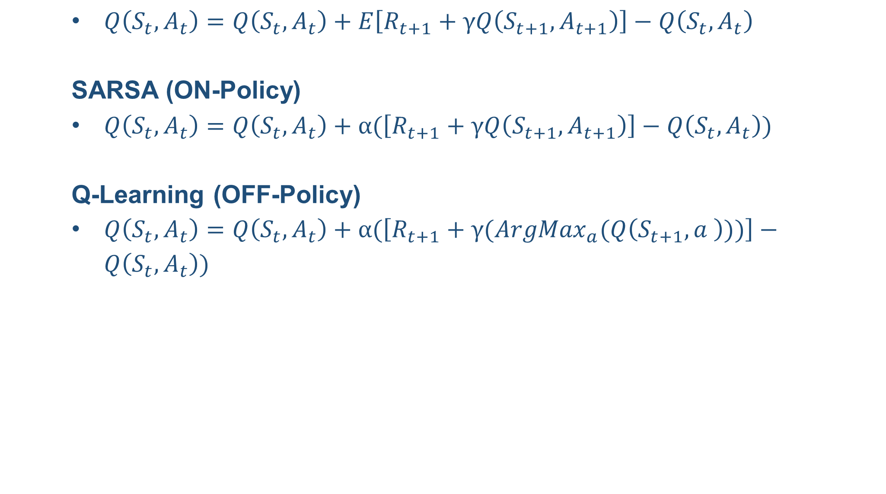
Temporal Difference Update
$Q\left(S_{t},A_{t}\right)=Q\left(S_{t},A_{t}\right)+E\left[R_{t+1}+γQ\left(S_{t+1},A_{t+1}\right)\right]−Q\left(S_{t},A_{t}\right)$
SARSA (ON-Policy)
$Q\left(S_{t},A_{t}\right)=Q\left(S_{t},A_{t}\right)+α(\left[R_{t+1}+γQ\left(S_{t+1},A_{t+1}\right)\right]−Q\left(S_{t},A_{t}\right))$
Q-Learning (OFF-Policy)
$Q\left(S_{t},A_{t}\right)=Q\left(S_{t},A_{t}\right)+α(\left[R_{t+1}+γ({ArgMax}_{a}(Q\left(S_{t+1},a \right)))\right]−Q\left(S_{t},A_{t}\right))$
Notes:
10

